Slide 1

Phishing Awareness
Be Aware and Do Not Take the Bait !

Slide 2
Importance of this Training
Cybercrime has become a powerful tool for stealing information. The
anonymity and convenience of the internet has enabled criminals to launch
highly targeted attacks with very little effort.
The most successful and dangerous of all the cyber attacks is phishing.
Security vendor research found over 94% of detected malware is delivered
via email, which makes phishing the #1 cyber threat to organizations. With
black market demand for information at an all time high, SCCE is
experiencing more phishing attacks. The attacks are becoming more
sophisticated, targeted, and increasingly difficult to identify.
The information in this training will increase your ability to identify a phish.

Slide 3
Table of Contents
01
02
03
04
What is Phishing ?!
Types of Phishing Attacks
Results of Successful Phishing Attacks
Tips for Identifying a Phish

Slide 4
01
What is Phishing

Slide 5

Phishing is an online scam where criminals send
fraudulent email messages, appearing legitimate.
The emails contain links or attachments that trick
recipients into entering confidential information
(e.g. account numbers, passwords) into fake
websites, or they infect computers with malware.

Slide 6
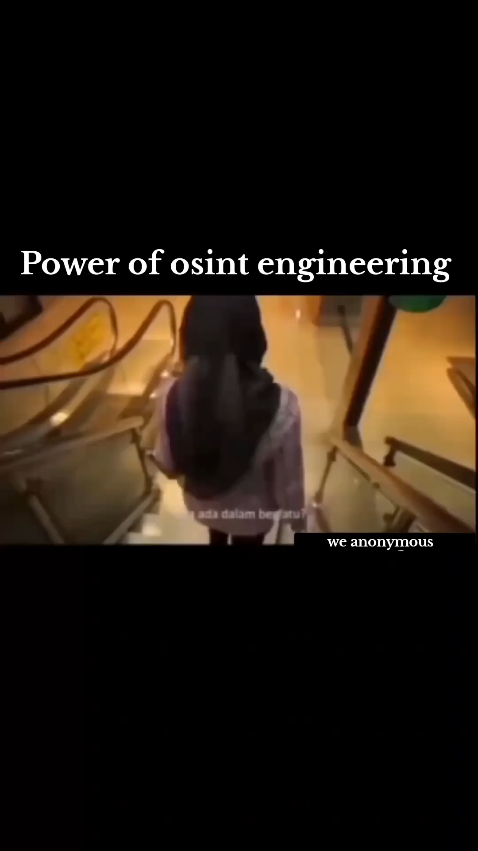

Slide 7
02
Types of Phishing

Slide 8
Types Of Phishing
01
Spear Phishing
04
Clone Phishing
02
Smishing
05
Whaling
03
Vishing

Slide 9
03
Successful Attacks Results

Slide 10

Successful Attacks Result in…
Identity Theft
Loss of Sensitive Information (personal or professional)
Loss of Intellectual Property
Data Sold to Criminals and Third Parties
Financial Losses
Unauthorized Transactions
Exposed Usernames and Passwords
Malware and Ransomware Installation
Backdoors (access to systems) to Launch Future Attacks
Reputational Damage

Slide 11

Tips for Identifying a Phish

Slide 12
Look for Messages with
Mismatched URLs
Poor Grammar or Spelling
Unexpected Correspondence /Unsolicited Requests
Urgent or Threatening Language

Slide 13


Slide 14
Thanks!
Do you have any questions?
kamelabdalla606@gmail.com
+20 1228861389
Linked-in

